Slide 1
Cis DevSecOps Mainframe
11/06/2019
Notes:
Title slide [uses Title Slide (Background Image) layout]
The brand mark and data art graphic on this slide layout are set up at the correct size and position and should not be altered.
The presentation title appears in Arial (Experian Dark Blue); other presentation details should be in Arial (Grey) and separated by a single line space, as shown in this example. It is important to ensure that the title and supporting text is always fully legible on an image background.
The background image has been placed in the slide layout master as a ‘background fill’; this can be edited by right-clicking the background image area and choosing ‘Format Background…’ from the context menu to replace the image. The full-colour brand mark and data art graphic must always appear on a light-coloured background with maximum legibility; image backgrounds should be carefully selected with this in mind.

Slide 2
Team Charter
Team Patagonia
Product Owner (PO)
Amit Awati (US)
Tech Lead & Scrum Master
Jaime Muñoz (CH)
Engineering Manager (EM)
Alvaro Fuenzalida (US)
Team Members
Sirigireddy, Sreelatha (IN)
Kuppili, Priyanka (IN)
Moka, Manoj (IN)
Ponnala, Madhukar (IN)
Badeti, Rajeshwari (IN)
Adhikari Biswash (US)

Slide 3
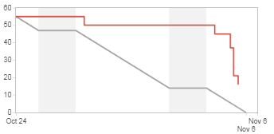
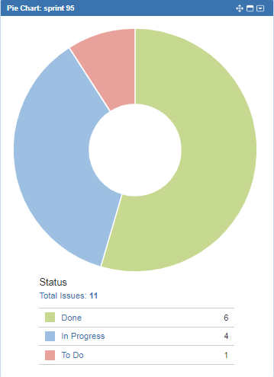
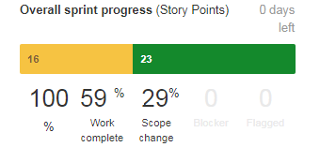
Sprint # Progress Summary

Slide 4
Sprint Goals and Details Status Report

Slide 5
PI Sprint Delivery Dashboard

Slide 6
Demo and Q&A
Demo Scope Summary
Apache Spark Deployment on Openshift ( Manoj Moka)
CD for weekly implementation release (Jaime Muñoz)

Slide 7
Q & A
Notes:
Closing slide [uses Holding Slide layout]
This slide can be used as a ‘closing’ slide and should not include any additional text or graphics. The same slide layout is used as a presentation opening slide. The brand mark and data art graphic on this slide layout are set up at the correct size and position and should not be altered.

